Slide 1
Georgia’s Air Quality and Respiratory Health
Chechen Yu
Erica Rosa
Joseph Moravitz
Shweta Shalini
Ted Stagner
Notes:
Erica

Slide 2
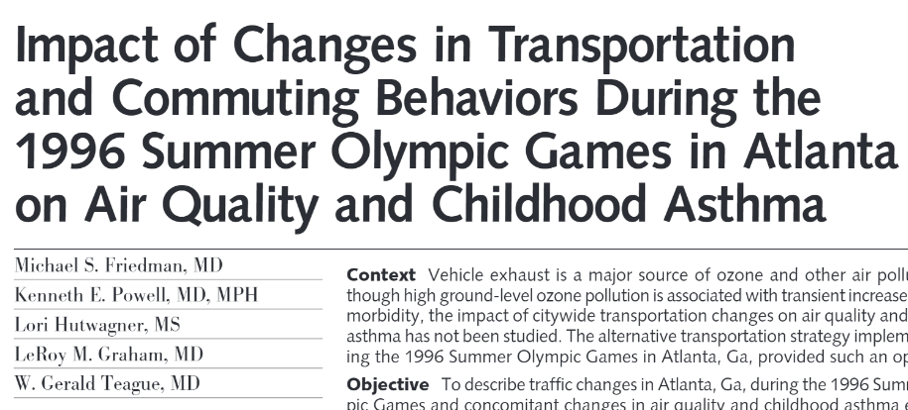
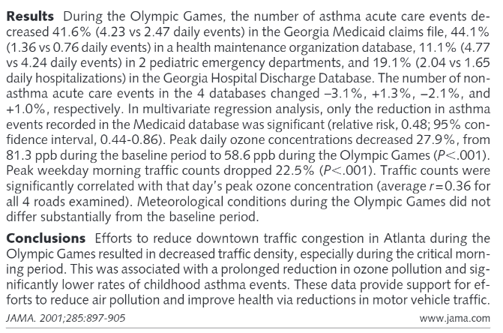
Background
How does traffic density affect respiratory health?
How has Georgia’s air quality changed over recent years?
How does Georgia’s air quality differ among its counties?
Is there a significant relationship between air quality and respiratory health in GA?
Notes:
Ted

Slide 3
Background
According to The Asthma and Allergy Foundation of America, 8% of the US population has asthma. Air pollution is linked to asthma exacerbation in susceptible individuals. The objective of our project was to explore and characterize the relationship between air pollution and asthma prevalence.
100
300
500
200
400
Particulate Matter
Ozone
NO2
CO
SO2
National Standard: <100
Air Quality Index | (AQI) Values | Levels of Health Concern
When the AQI is in this range: | ..air quality conditions are:
0 to 50 | Good
51 to 100 | Moderate
101 to 150 | Unhealthy for Sensitive Groups
151 to 200 | Unhealthy
201 to 300 | Very Unhealthy
301 to 500 | Hazardous
Notes:
Chenchen
The EPA calculates the AQI for five major air pollutants regulated by the Clean Air Act: ground-level ozone, particle pollution (also known as particulate matter), carbon monoxide, sulfur dioxide, and nitrogen dioxide.
Think of the AQI as a yardstick that runs from 0 to 500. The higher the AQI value, the greater the level of air pollution and the greater the health concern.
https://cfpub.epa.gov/airnow/index.cfm?action=aqibasics.aqi
Asthma 8%: http://www.aafa.org/asthma-facts/

Slide 4
Data and Methods
We explored asthma emergency visits by county from 2010 to 2017, as the dependent variable. Independent variables included air quality index (AQI) & air pollutants (Ozone, PM2.5, and PM10). These variables were controlled for meteorological conditions and analyzed using time-series and liner regression models. Additionally, a student t-test was used to test the significant level of difference of asthma emergency department visits and air quality between rural and urban areas.
Data Sources
Python Methods
EPA AirNow Database
CDC Behavioral Risk Factor Surveillance System (BRFSS)
GA OASIS Asthma Data
Google Maps API
Data munging via Pandas
Plotting via Matplotlib
Statistical analysis via scipy
Geocoding/mapping via gmaps
Notes:
Erica

Slide 5
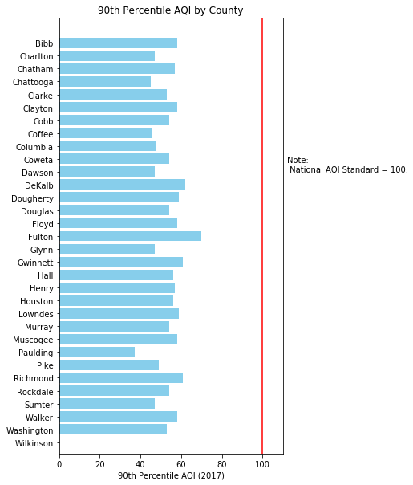
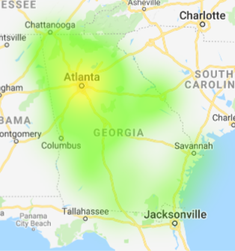
Georgia | By County (2017)
Notes:
Erica
% of GA counties where air quality does not meet national standards by year
Point out yellow / urban

Slide 6
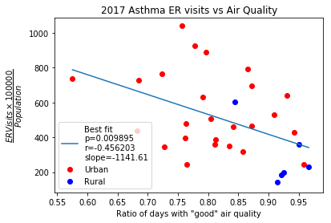
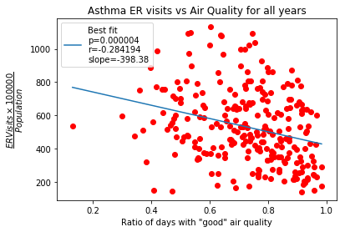
Georgia | By County Type
Notes:
Joseph
Urban / rural stats - # good days ratio
Good days: not above 50 AQI

Slide 7
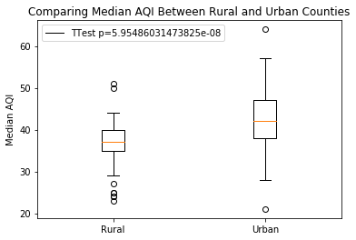
Georgia | By County Type
Notes:
Joseph
Ttest median AQI between urb / rural – significant
Median value = 37 (rural), 42 (urban)
Mean values = 36.79 (rural), 42.35 ( urban)

Slide 8
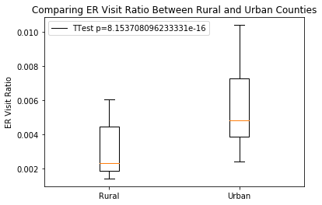
Georgia | By County Type
Notes:
Joseph

Slide 9
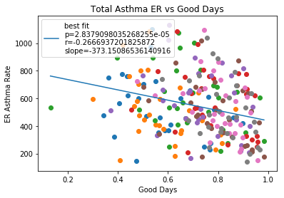
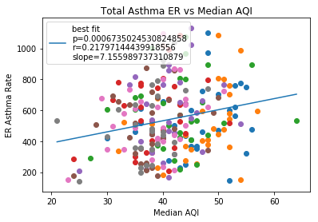
A Closer Look at Childhood Asthma Visits
Notes:
Ted

Slide 10
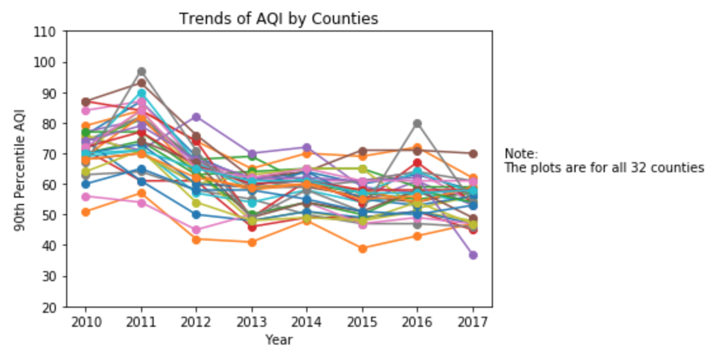
Georgia Air Quality Over Time
Notes:
Shweta
Point out 2011 spike

Slide 11
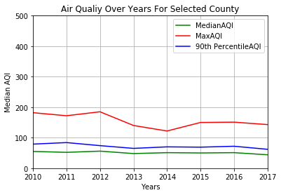
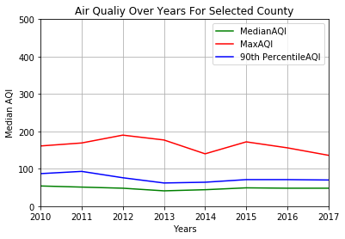
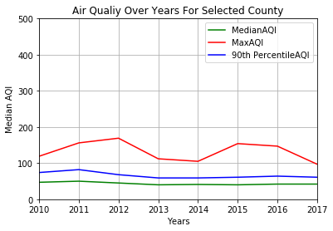
User Input Demo
Jupyter Notebook
Notes:
Shweta
Screenshot of demo

Slide 12
Observations & Conclusions
Air quality in Georgia has changed over time. For all counties for which we have data, it appears to have slightly improved.
There is correlation between air quality and number of asthma-related visits to ER. Due to a low correlation coefficient, AQI is not a very strong indicator of what will cause a spike in urgent asthma incidents. There are likely larger factors at play.
Looking at urban vs. rural counties – there is a significant difference when observing air quality. Additionally, between 2010 – 2017 - rural counties showed a statistically significantly smaller rate of ER asthma visits than urban counties. Thus, a relationship can be determined between county type and likeliness of air quality causing urgent asthma incidents.
There is not a strong difference between the amount of asthma ER visits for children vs all ages, as a result of air quality.
Notes:
Chenchen

Slide 13
Limitations
No reliable traffic density data
Did not see the same results as 2001 study
Limited to 32 out of 159 counties for air quality
Air quality data was limited to yearly. Values provided daily, monthly, or even seasonally would have been richer data for analysis.
Data on individual air pollutants was not appropriate to answer the research questions we had. If it was more appropriate, we could have observed potential trends for each pollutant.
Notes:
Shweta

Slide 14
THANK YOU!
Any questions?
Notes:
Everyone

